Slide 1


Key Success Factors of Digital Transformation
Vision and Mission
Strategy
KRAs and KPIs
Process Workflow
Business Process Cycle
Instinctual Connect
Measurement
Change Management
Digital Technology
ICT
Moore’s Law
Internet
Data Communication
SMAC
IoT
Software
Tools
Digital Strategy and Process
Digital Mindset & Skills
Disruptive Innovation
Non-disruptive Innvn
Common techniques
Cross-Pollination
Intersection & Fusion
Dare-To-Try
Innovation in DX
Backbone & Empwrmt
Risk-takers
Data-Driven
Customer Obsessed
Tech-savvy
Business-savvy
Agile
Empowered
Adaptable
DIGITAL TRANS-FORMATION
Innovation –Business Models &
Technology
Business Technology Alignment
Cust Interaction stages
Customer Touchpoints
Data Collection
Fm Data to Insights
Fm Insights to Strategy
Customer Life Cycle
Customer centricity
Voice of Customer
Outcome driven
Shared Culture
Strategy alignment
Structure alignment
Process alignment
Drive for Innovation
Aligned Priorities
Tactical alignment
Customer Experience Management
Drive for DATA is embedded in each KSF
© Ashish Pachory

Slide 2

Lecture Series
Innovation
apachory@iitgoa.ac.in
Ashish Pachory

Slide 3
Breaking the barriers …
There is no reason anyone would want a computer in their home.
Ken Olson, President, Chairman, and Founder of the Digital Equipment Corporation (1977)
There is practically no chance that communication space satellites will be used to provide better telephone, telegraph, television, or radio service:T. Craven, FCC Chief (1961)
The Internet will soon go spectacularly supernova and in 1996 catastrophically collapse: Robert Metcalfe, the inventor of the Ethernet (1995)
A rocket will never be able to leave the earth’s atmosphere: NYT headline based on collective scientific view (1936)
Heavier-than-air flying machines are impossible: Lord Kelvin, British physicist
The energy produced by the breaking down of the atom is a very poor kind of thing. Anyone who expects a source of power from the transformation of these atoms is talking moonshine: Ernest Rutherfold(1933)
There will never be a bigger plane built: Boeing Chief engineer after the first flight of Boeing 247- a twin engine plane that could hold 10 people (1977)
The cinema is canned drama. What audiences really want is flesh and blood on the stage: Charlie Chaplin
There is not the slightest indication that nuclear energy will ever be obtainable. It would mean that the atom would have to be shattered at will: Albert Einstein (1932)
Television will not be able to hold on to any market it captures after the first 6 months. People will soon get tired of staring at a plywood box every night: Darryl Zanuck, producer
I must confess that my imagination refuses to see any sort of submarine doing anything but suffocating its crew and floundering at sea: HG Wells, famous sci-fi writer
The idea that the cavalry will be replaced by these iron coaches is absurd. It’s a little short of treasonous: The aide-de-camp to Field Marshall Haigwhile witnessing a tank demonstration (1916)

Slide 4

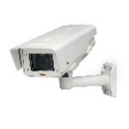
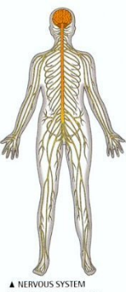

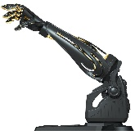
Future Possibilities…
Brain-Computer Interface
Computer-Brain Interface
London
EMBEDDED
Brain-Computer Interface
TRX
Computer-Brain Interface
New Delhi
Singapore

Slide 5
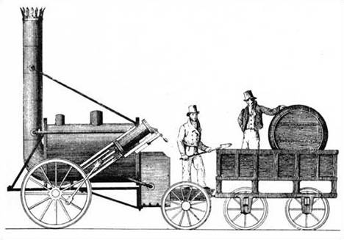
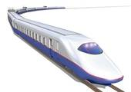
Innovation in the context of Business
Desirable
INVENTION RL Stevenson
INNOVATION
Feasible
Doable
Viable

Slide 6
What is Disruptive Innovation?
H
Disruptive Innovation
Technology improves exponentially
Performance
Scope for GREENFIELD Innovation (Disruption)
Improvement in Performance
M
Garden Variety Innovation
Customer needs, Performance demand grow incrementally
Business, Social and Political Change
L
Business As Usual
Time
L
M
H
Technological Change

Slide 7

Innovation techniques @ work: Bucketization
School
Smallest buckets
My Education
College/Univ
Buckets
Extracurricular
Projects & Assignments
My Experience
Me
Skills, Tools, Certifications
BUSINESS PROBLEM
Family & Social background
My Personal Life
Hobbies, Com-munity work
Learning and Growth
My Future Plans
Long term vision

Slide 8
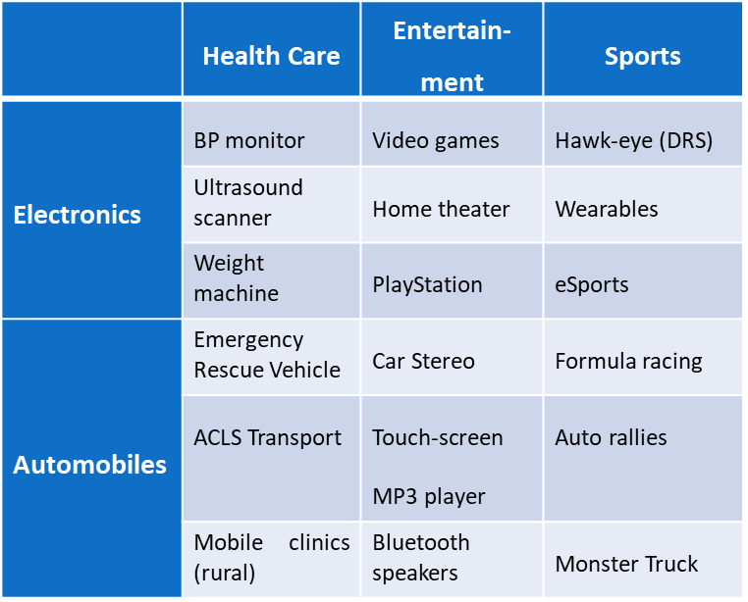
Innovation techniques @ work: Fusion
Innovations spawned by Intersection in everyday life:
Innovations spawned by Intersection of Digital Technologies:
 | Cloud | Big Data | Mobility | Social Media | IoT | Apps
Cloud | IaaS. PaaS. Shar-ed Computing | CEM | Mobile Banking | Shared Storage [Social Cloud] | Video Surveillance | Interactive Gaming
Big Data | Facial Recognition | Storage. Correl-ation. Analysis | GPS Navigation (Google Maps) | Sentiment Analytics | Machine Learning | Decision Support Systems
Mobility | e-commerce | Mobile BI | Freedom from devices and n/ws | Instant multimedia messaging | Connected Cars | Mobile Ent Apps (Salesforce,...)
Social Media | Chatbots (Alexa) | Personalized Campaigns | BYOD | Audio, Text, and Video Inst Msgng | Remote Health Monitoring | Lync Skype
IoT | Smart Homes | Disaster Warning (EWS) | IR Motion Trackers | IPv6 based social n/w of “things” | Machine-to-Machine Commn | Embedded Apps
Apps | SaaS | Data mining and BI Apps | Location-based Services | Facebook, Twitter | Custom IoT Apps | Sw programs for mobile devices

Slide 9

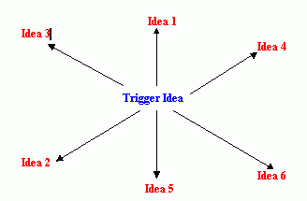
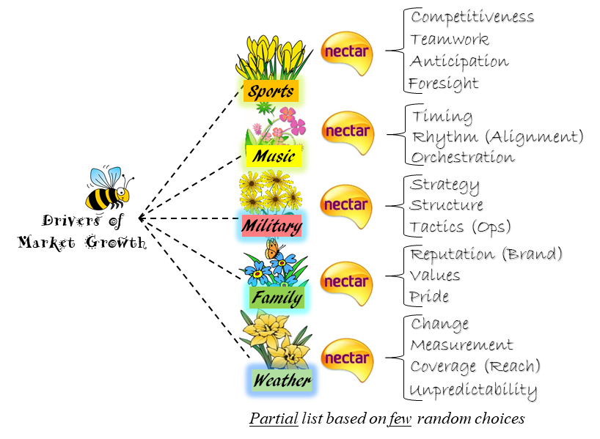
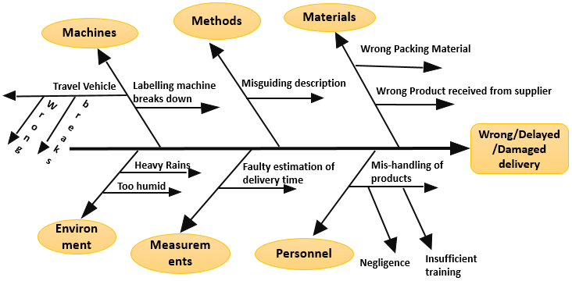
Popular Innovation Techniques
BRAIN-STORMING
ASSOCIATION
CROSS-POLLINATION
FISH-BONE

Slide 10
Lateral Thinking
E
C
B
AC = OB = Radius = 3+1 = 4
O
3
A
1
D
AC = ?

Slide 11
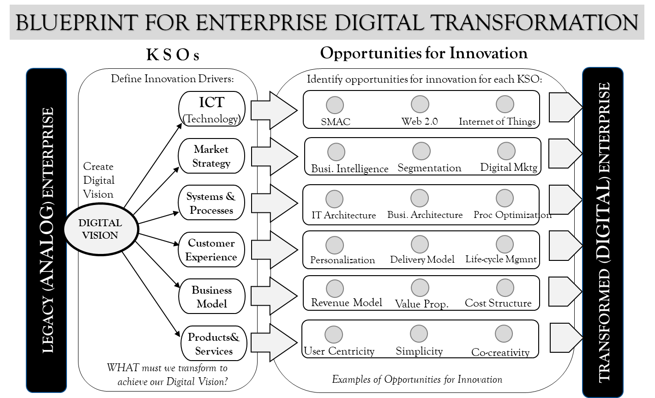
Blueprint for Digital Transformation

Slide 12
DX Scenario Ideas for Case Study
1. Retail Marketplace: From Store to Online
2. Travel Ticketing: OTC to Mobile App based
3. Startup: Food Delivery Chain
4. Startup: Online training classes
5. Hotel Front-office digital transformation
6. Demand-Supply harmonization (Mfg)
7. Parcel Delivery Service
8. Cloud-based Content Management and Delivery
9. Auto-parts aggregator
10. Healthcare center operations (patient care – e.g. vaccinations)
11. Any idea of your own (approved by me or Dr Mittal)
Include
- Vision/Mission
- Innovation Drivers (Pick at least 5):
ICT/Technology
Market Strategy
Processes
Customer Experience
Culture and Mindset
Business Technology Alignment
Business Model
Monetization
Products & Services (Value Prop)

